Slide 1
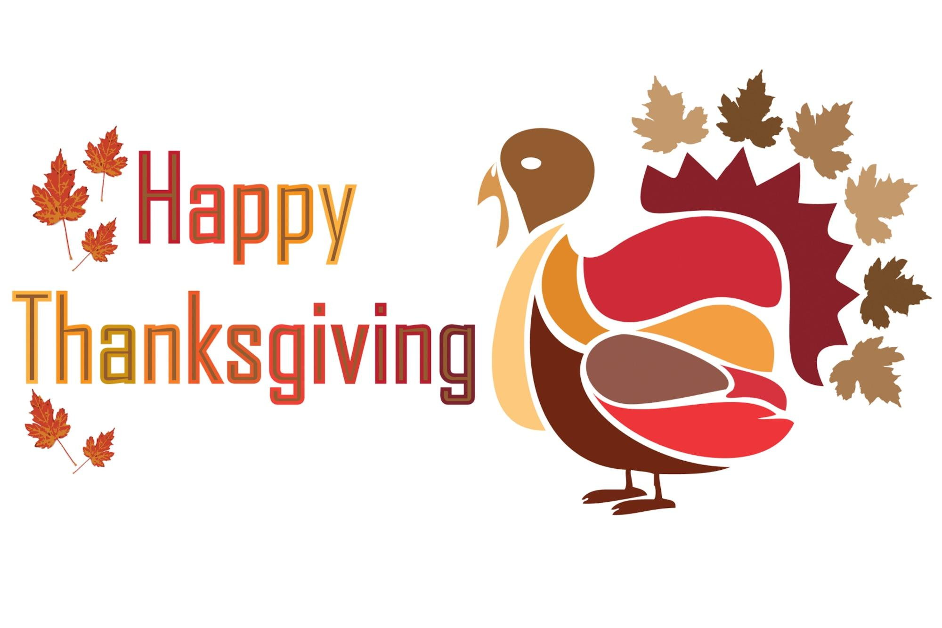
Cluster Connections
November-December 2024
Ms. Quaranto-Computer Technology Teacher
Ms. Gill- Science Teacher
Ms.. Lyons-Mayers~ Writing Teacher
Mr. Prince~ Physical Education Teacher
Computer Technology
This month all grades will be focusing on being a good Digital Citizen and using the online platform, “Seesaw.”
Seesaw is a platform where students can share their ideas, imagination, and understanding through writing, art, voice, and video. This will be used in combination with all academic areas we are visiting in the lab.​
Every student will be given a QR student badge to use at home to reinforce what was learned in the lab. A family QR badge will also be included, giving you the opportunity to visit and interact with your child’s digital portfolio.
​
Each grade will continue practicing how to login to various programs using their personal google email addresses. ​
*Please reinforce the skill of practicing this information at home, daily. Also, reminding your child that this is something that should not be shared. Safety First!!!​
Visit the Computer Lab website:​
https://sites.google.com/schools.nyc.gov/ps272quaranto342/home​
*Please make sure your child checks for feedback on their work, using the App or website for: Seesaw (k-5)
By using the link above, students can go to Seesaw easily, as we do it the same way in the lab. ;-)
​
Please visit my website for the latest information and educational games we use in technology.
https://sites.google.com/schools.nyc.gov/p-s-272-quaranto342/home
“Oh, the places you’ll go... Oh, the things
you’ll see, with Technology!”
- Dr. Seuss Technology
Physical Education
Mr. Prince – Physical Education
As we transition into the months of November and December, our students will apply their knowledge of Safety and Management established during the month of September. The students learned class protocols and expectations that promote safe and active participation in a positive environment. Students also learned about personal responsibility, safety and proper equipment use. Additionally, students will apply what they learned about Community Building, where we practiced social and emotional awareness, self-management, and responsible decision making.
During the months of November through December, our students will be introduced to the theme of Locomotor Skills. The students will be learning and enhancing locomotor skills through the application of movement concepts related to space and effort. Basketball drills, soccer drills and the rehearsal of NYCDOE Fitnessgram will allow our students to develop critical skills necessary for sports-related activities. Participation in these activities will also build on the students’ athletic confidence to participate in physical activities now and in the future.

Slide 2
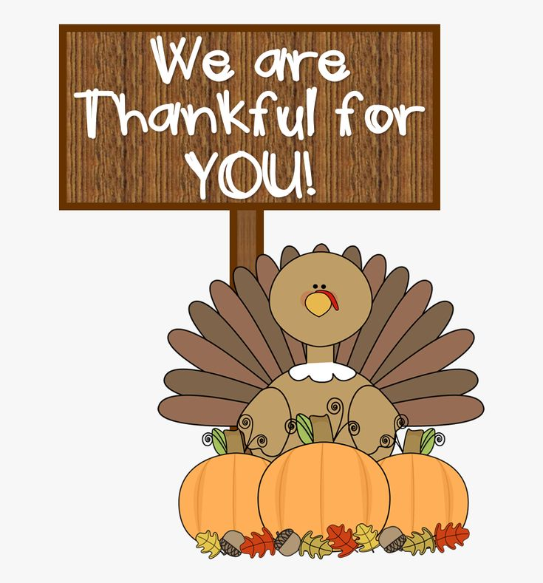
Cluster Connections
November-December 2024
Ms. Gill ~ Science Teacher
Science is about the miracle of the mundane - -
and children can appreciate this best.
Every child is a SCIENTIST!
For the months of November and December students will be covering the following units.
Grades Units
K Living Things
1st Life Science
• Nature’s Design 1-LS1-1
• Animal Families 1-LS1-2
• Family Traits 1-LS3-1
2nd Life Science
• Needs of a Plant 2-LS2-1
• How Animals Help Plants 2-LS2-2
3rd Life Science
• Surviving in Different Habitats 3-LS4-3
• Environmental Changes 3-LS4-4
4th Life Science
• Plant & Animal Structures 4-LS1-1
• Animal Senses & Behavior 4-LS1-2
5th Earth Science
• Brightness of Stars 5-ESS1-1
• Earth & Space Patterns 5-ESS1-2
• Earth’s Spheres 5-ESS2-1
Ms. Lyons-Mayers~ Writing Teacher
I believe that a child going without an education is a crime.
- Kamala Harris
Greetings, every scholar is entitled to a free and appropriate education. Therefore, let's foster our commitment to scholarship by building writing skills in our most valuable assets: our children . Writing skills can improve by having scholars write on various topics at home, reviewing the skills taught in class or having scholars keep a journal of life events. Please review with your scholar(s) writing standards on a daily basis.
November - December 2024
5th Grade: Scholars will use informational writing and research skills to inform their audiences about a historical event. As a result from being inspired by historical events scholars will write narratives about achieving their future goals.

Slide 3
Cluster Connections
November-December 2024
Ms. Lyons-Mayers~ Writing Teacher (Continued….)
4th Grade: Scholars will use evidence from various non fiction sources to support their informative writing about several topics. Scholars will also perfect their skills when writing narratives about a text.
3rd & 2nd Grades: Scholars will use evidence from a story to describe character traits. Personal narratives and informational skills will be developed and utilized to improve scholar's performance in writing.
1st Grade: Scholars will develop their skills of writing by learning the effectiveness of organization, brainstorming ideas, and foundations of writing.
Kindergarten: Scholars will learn foundational concepts of writing. Draw & write will be used to build text to illustration concepts; while exploring opinion writing techniques.
Thank you,
Mrs. LyonsMayers
*Digital citizenship is the ability to use technology responsibly and respectfully, and to be an active participant in the digital world. It includes:
Protecting privacy
Knowing how to protect private information online, and using strong passwords to prevent identity theft and data breaches
Being respectful
Being mindful of how your actions online can affect others, and respecting their right to privacy
Using technology responsibly
Knowing how to use social media responsibly, and how to find reliable sources online
Being aware of risks
Understanding the risks of cyberthreats and online threats, and how to mitigate them
Contributing to the community
Working to contribute to the health and well-being of your communities, and being an active participant in the digital world

