Slide 1
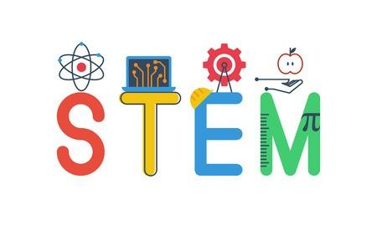
Cluster Connections
September/October 2024
Cluster Team:
Ms. Quaranto~ Computer Technology Teacher
Ms. Gill~ Science Teacher
Mr. C. Prince~ Physical Education Teacher
-----------------------------------------------------------
Computer Technology
Mrs. Quaranto
Welcome Back to School! My name is Mrs. Quaranto and for those of you that do not know me already, I am the Computer Technology teacher at P.S. 272. I have been teaching here since 2002 and genuinely enjoy every minute of it.
In the computer lab, we learn how to stay safe while using the internet. This year I will
teach computer science in the lab. The lower grades will focus on robotics and the upper grades will learn the basics of 3D printing.
Also, your child will learn proper hand placement on the keyboard and how to use the mouse. they will learn how to login to their school email accounts and memorize username and passwords.
Lastly, as we already know computers and technology play a vital role in today’s world, and I am so excited to share the latest advances with your child.
Looking forward to a productive school year!
“Oh, the places you’ll go... Oh, the things
you’ll see, with Technology!”
- Dr. Seuss Technology
Computer Lab Website~Resources
https://sites.google.com/schools.nyc.gov/ps272quaranto342/home
Science
Ms. Gill
Welcome to the new school year! I’m Ms. Gill and I am looking forward to being your child/children science teacher this school year. For this school year we will be focusing on the four C’s of 21st Century skills: Critical thinking, Creativity, Collaboration and Communication as students engage in and explore areas in life science, earth science and physical science. Thanks for your cooperation and support as we move forward.

Slide 2
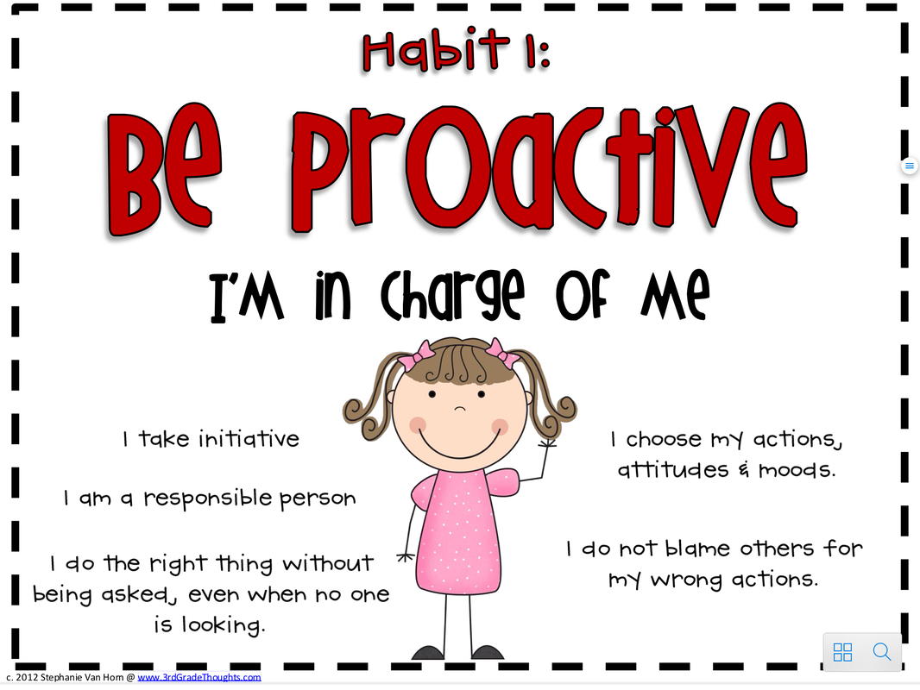
Cluster Connections~Continued
September/October 2024
Physical Education
Students and Families,
Welcome to the 2024-2025 Physical Education Program. This school year our students can look forward to a fun, challenging, and rigorous Physical Education experience. Students of Pre-K – 5th grade will begin the school year learning and engaging in safety management and community building.
The Instructional Goals for K-5 Physical Education Program for September and October are as follows:
September 2024
Safety & Management:
Teachers and students establish and practice class protocols and expectations promoting safe and active participation in a positive environment that is focused on student learning. Personal responsibility, safety, proper equipment use, and student engagement are emphasized as well.
October 2024
Community Building:
Students develop and practice social-emotional skills through active collaboration with others in partners, small group, and large group activities. Emphasis is placed on self-awareness, social awareness, self-management, and responsible decision making to develop positive interpersonal skills that extend beyond the P.E. setting.
I look forward to working together to make the most of your child's physical education experience.
Regards,
Mr. Prince
Think:
What is one way you can be proactive in school or at home?

